Slide 1

Process Maps As Code
With mermaid
Richard Jackson | @jacksorjacksor
Umbraco Kent Meetup | 14th November 2024

Slide 2
CONTENTS
Introduction (“The meme that haunts”)
Code to visuals (“Graphic design for developers”)
Mermaid JS
Reflections (“Why bother?”)

Slide 3
ABOUT ME

Slide 4
1. The Meme that haunts

Slide 5
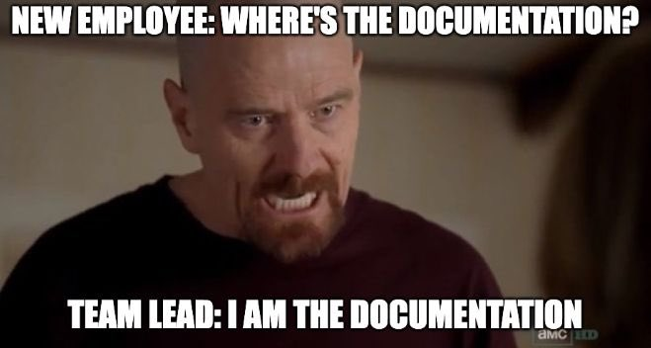

Slide 6
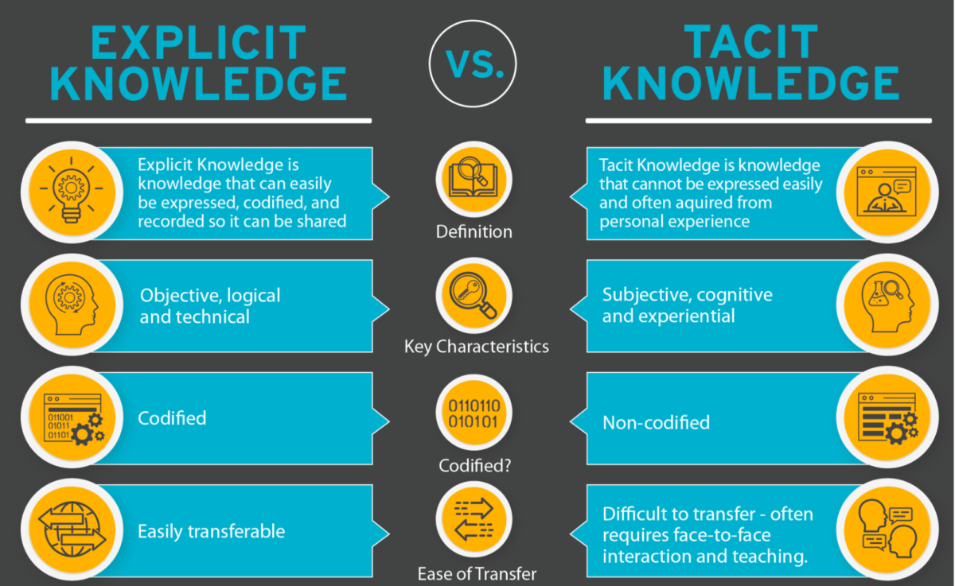
Source: https://document360.com/blog/explicit-knowledge/

Slide 7
Visual aids TO SUPPORT documentation
Placeholder:
TACIT KNOWLEDGE
“How could I have known that?”

Slide 8
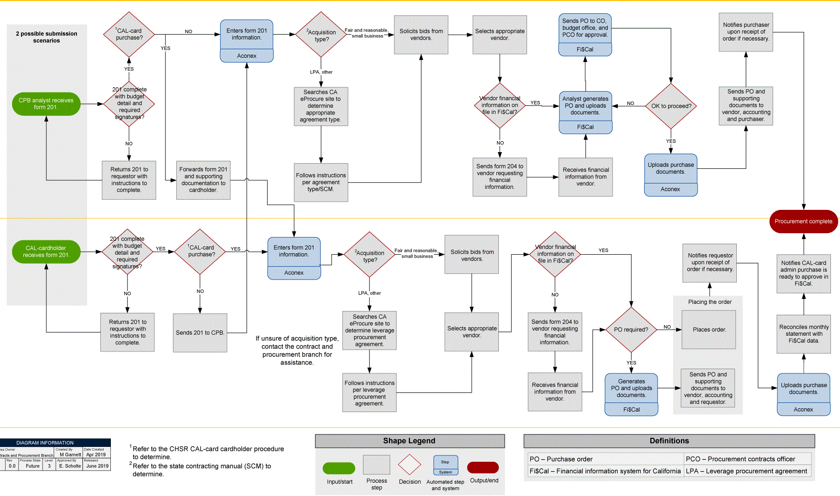
What is process mapping?
Creation of a visual representation of work
Communication exercise to define workflow, resources and responsibility
High-level, non-technical documentation which should be understandable across the business

Slide 9
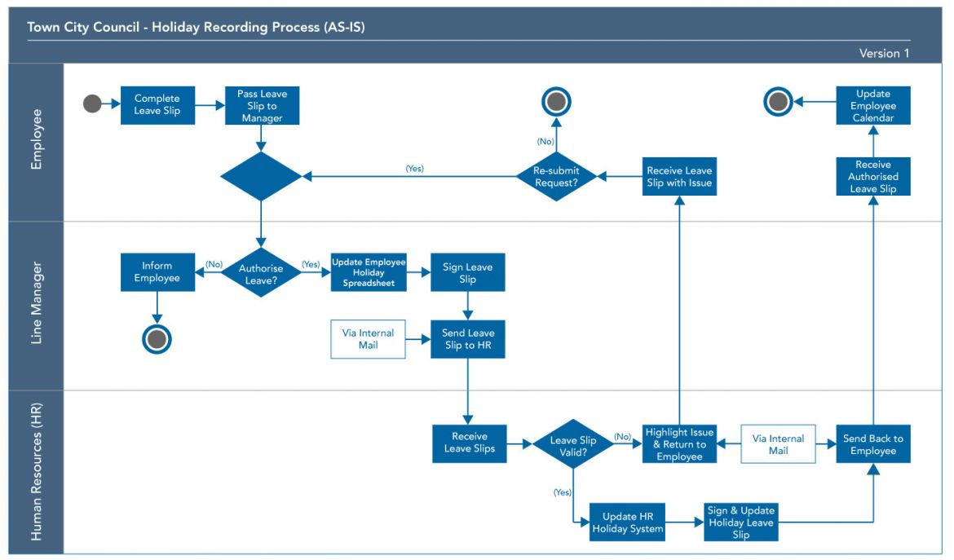
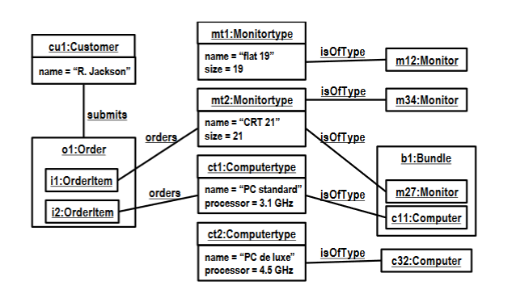
Different levels of process visualisation
Process Mapping
Process MODELLING
High-level
Subjective
Low-level
Objective

Slide 10

Benefits of process mapping
Provides single source of truth for discussion, iteration and improvement
Challenges assumptions
Reduces tacit knowledge
Improve onboarding of new staff
Creates empathy between departments

Slide 11



Graphics Packages for Process Mapping
Diagrams.net
(formally Draw.io)
Lucidchart
Microsoft Visio

Slide 12
Key problems
Proprietary file formats
Separate file to the work
Requires upskilling on graphics package
Developers not necessarily comfortable with aesthetic design
Maps can become unwieldy as scope increases

Slide 13
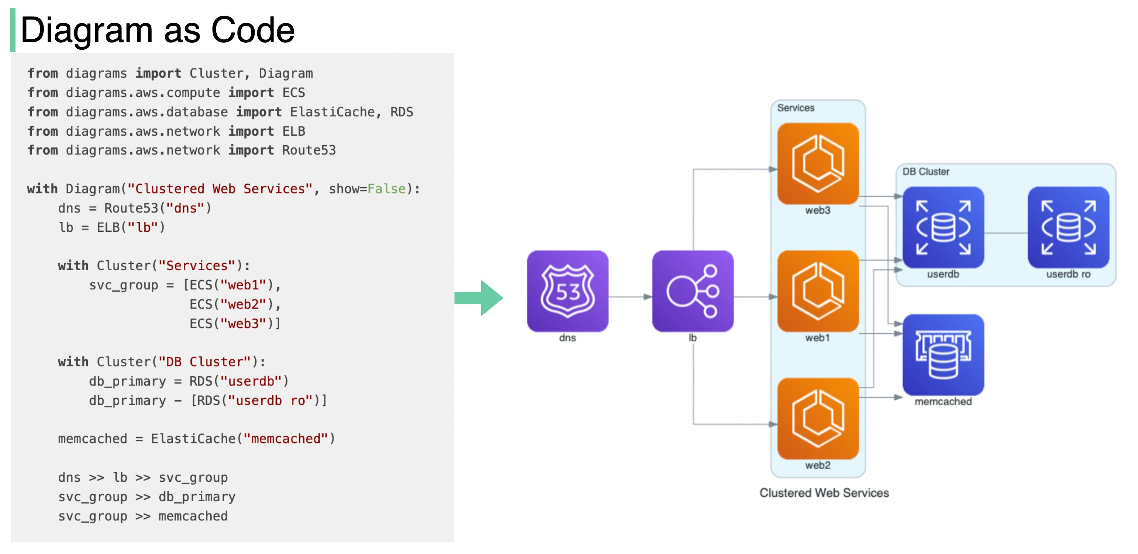
PROCESS MAPPING AS CODE (hey it’s the name of the talk)
Source: Diagram as Code - by Alex Xu - ByteByteGo Newsletter

Slide 14

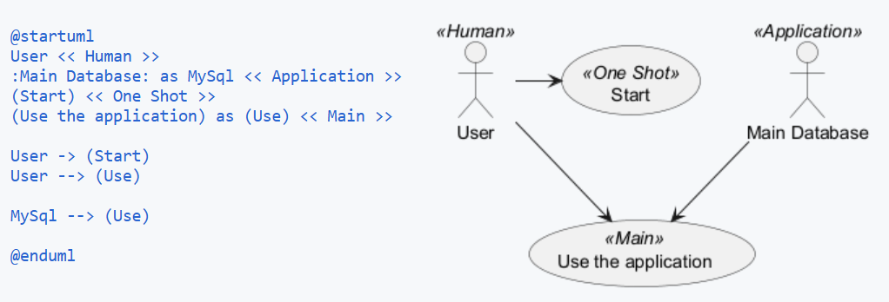
PlantUML

Slide 15

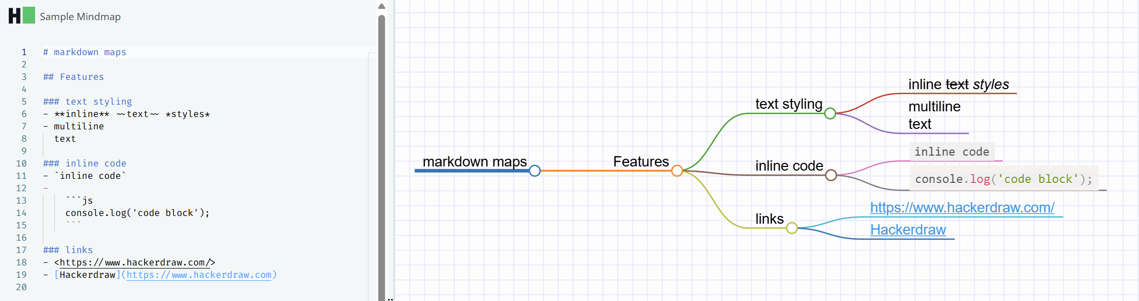
HackerDraw

Slide 16
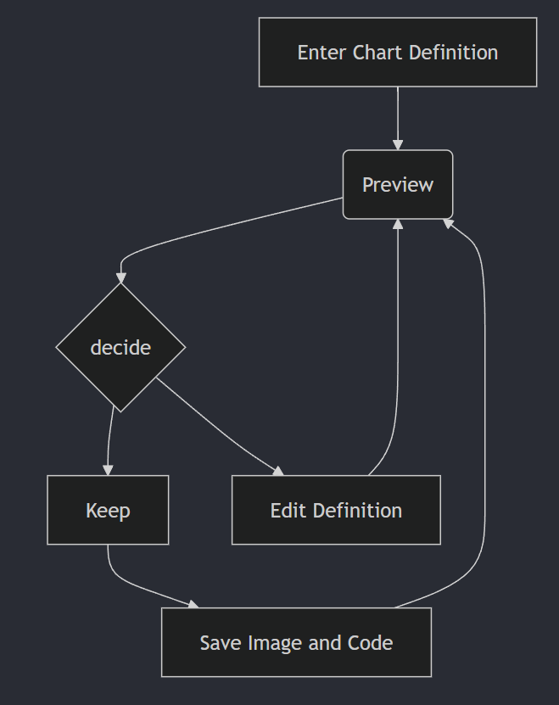
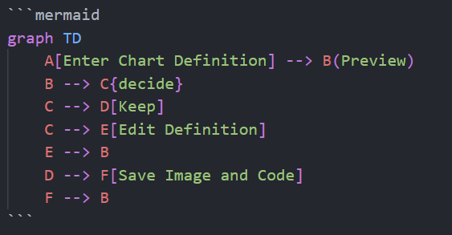
Mermaid

Slide 17
About Mermaid
JavaScript-based diagramming and charting tool
Won the JS Open Source Awards (2019) category "The most exciting use of technology"!!!
Goal: “help documentation catch up with development”

Slide 18

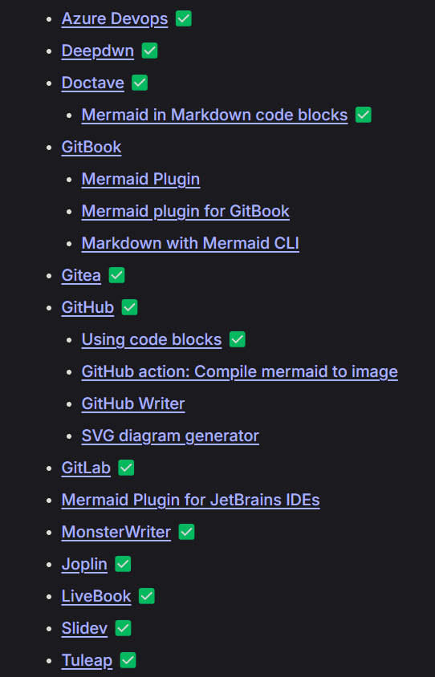
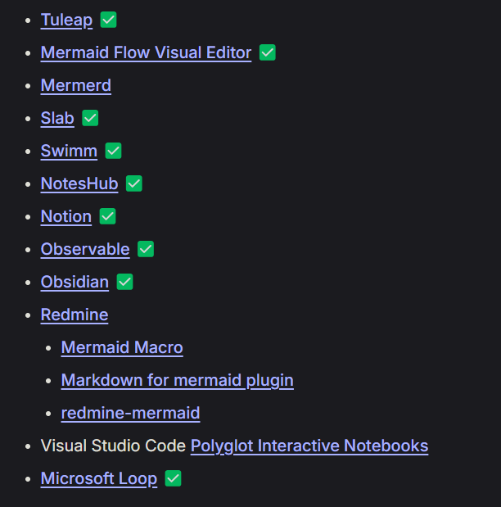
Mermaid JS Integrations
Native support for Mermaid
Notes:
Source control platforms
Notetaking / information management tools

Slide 19
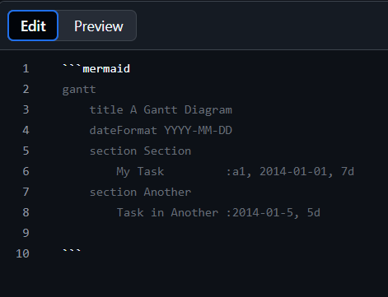
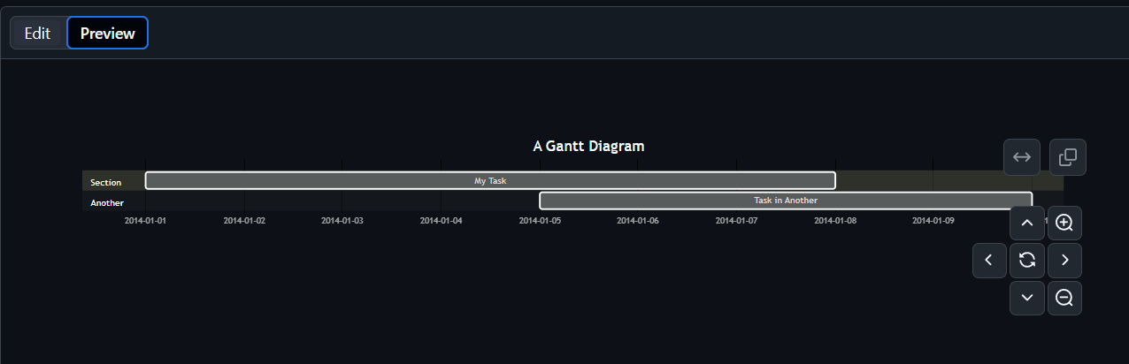
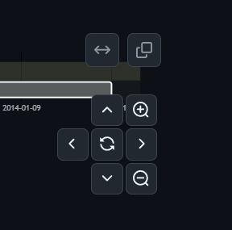
GitHub
Any Markdown file
Available since Feb 2022:
Include diagrams in your Markdown files with Mermaid - The GitHub Blog

Slide 20
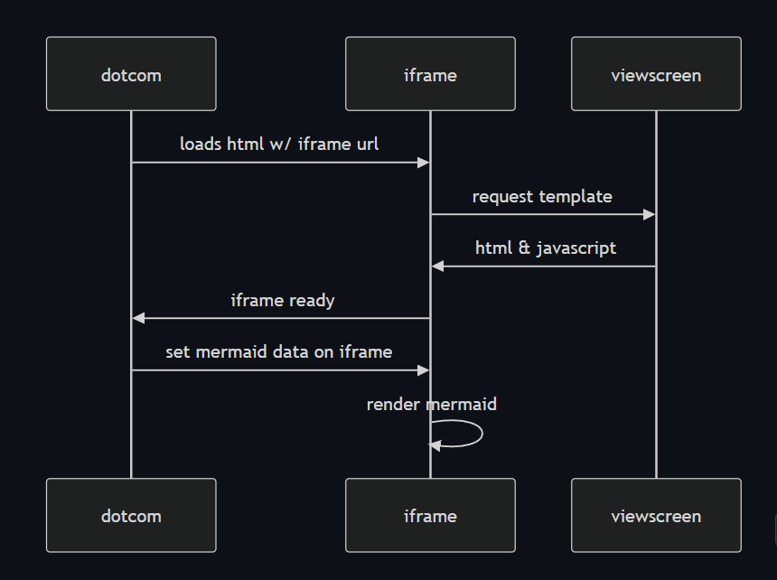
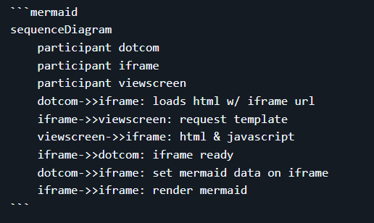
GitHub Mermaid rendering Process
Source: GitHub HTML Rendering Pipeline

Slide 21
Azure DevOps

Slide 22
Visual Studio Code

Slide 23
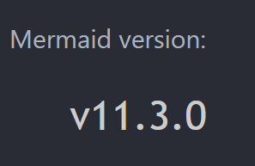
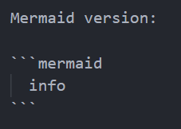
EXAMPLES
Code
Render
[name of file] > [name of rendering application]

Slide 24
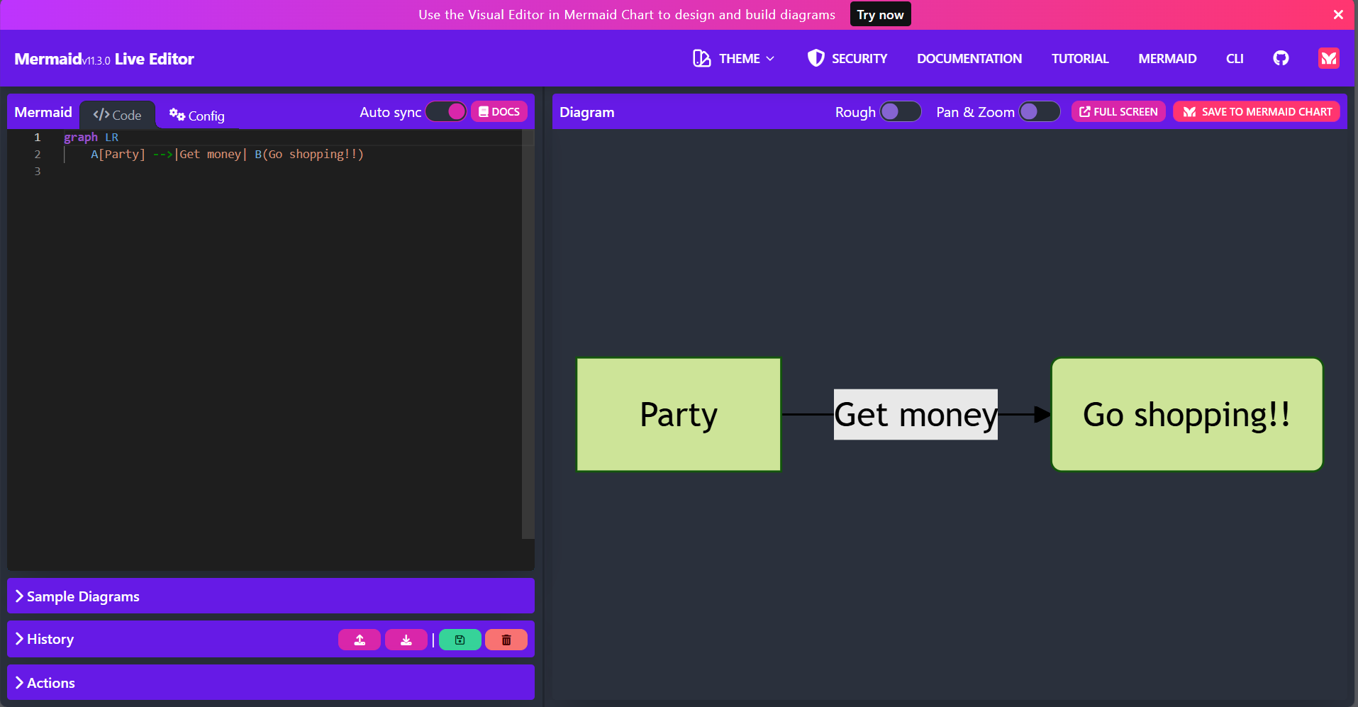
Use by non-developers: Mermaid Live Editor

Slide 25
Process Mapping Considerations
Maybe?

Slide 26
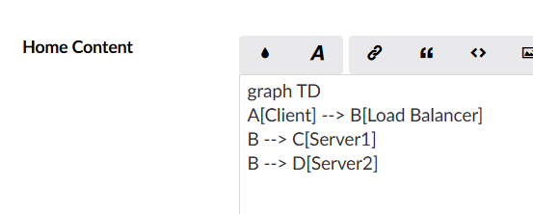
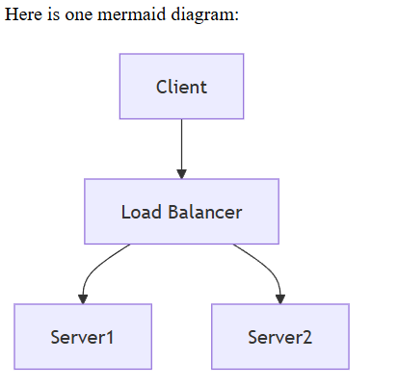
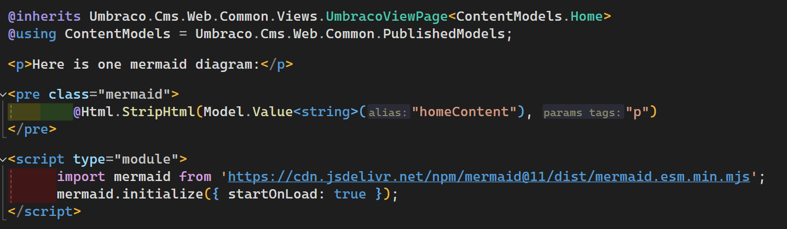
Umbraco CMS (v13)
[Markdown Editor]

Slide 27
Notes:
Import module (by any means necessary) – CDN, NPM package etc.
Create a pre tag with class “mermaid”
Import content, removing <p> tags

Slide 28
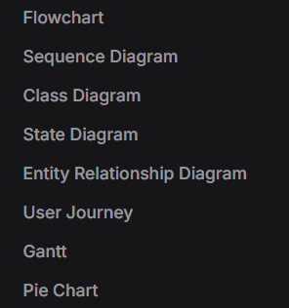
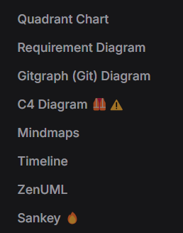
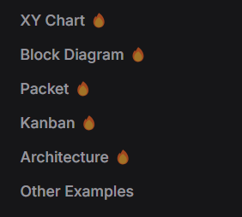
Diagram Types
(added Oct 30th)

Slide 29
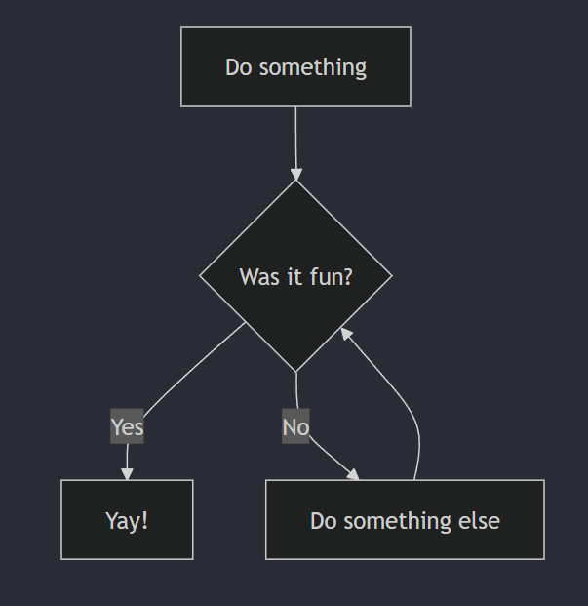
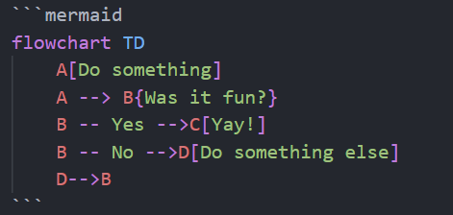
Flowchart

Slide 30
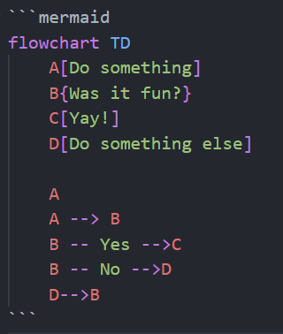
Separate Assignation to Usage

Slide 31
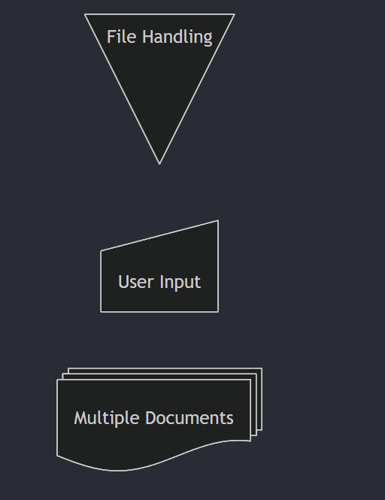
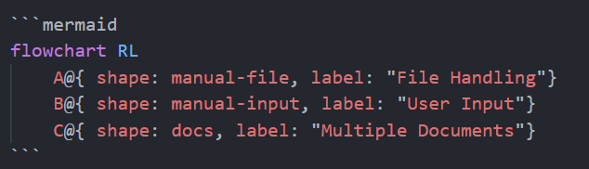
Defining Shapes
Flowcharts Syntax | Mermaid

Slide 32
Checking Versions
Code
Render
test.md > Visual Studio Code

Slide 33
Click actions
%% Click Actions
click 0_H "https://nightingalehq.ai/";

Slide 34
Mermaid limitations
HIGHLY opinionated – users have zero control over layout
No swimlanes (!!!)
Use swimlanes in flowchart diagram · Issue #2028 · mermaid-js/mermaid

Slide 35
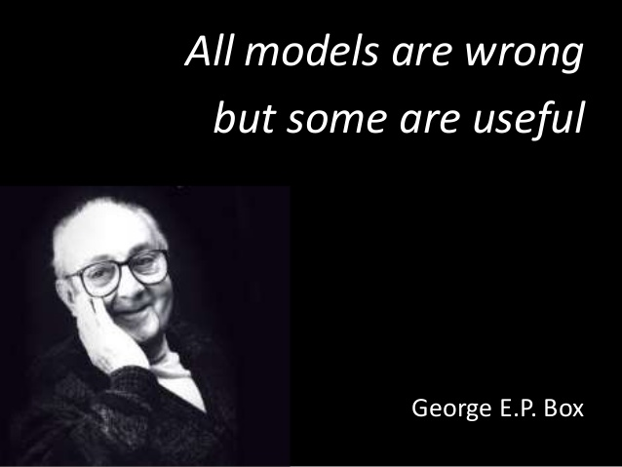

Slide 36
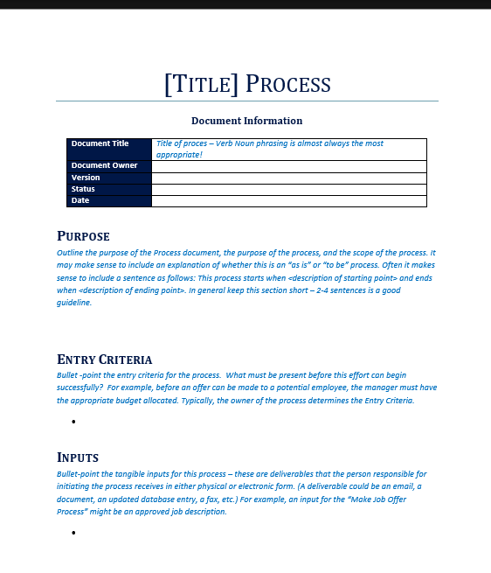
Process Maps in communication
Distribute all process maps between all departments
Ensure access for all staff
Consider using a “Business Process Template”
Codifies process for cross-business discussions

Slide 37
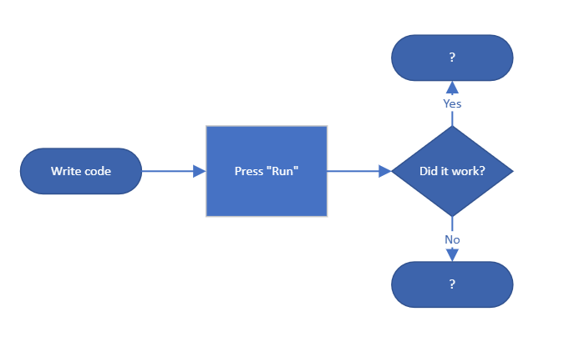
Process Maps for onboarding
Have process maps for new starters
Have new starters make process maps to help them learn / test assumptions
Gives basis for discussion and research

Slide 38
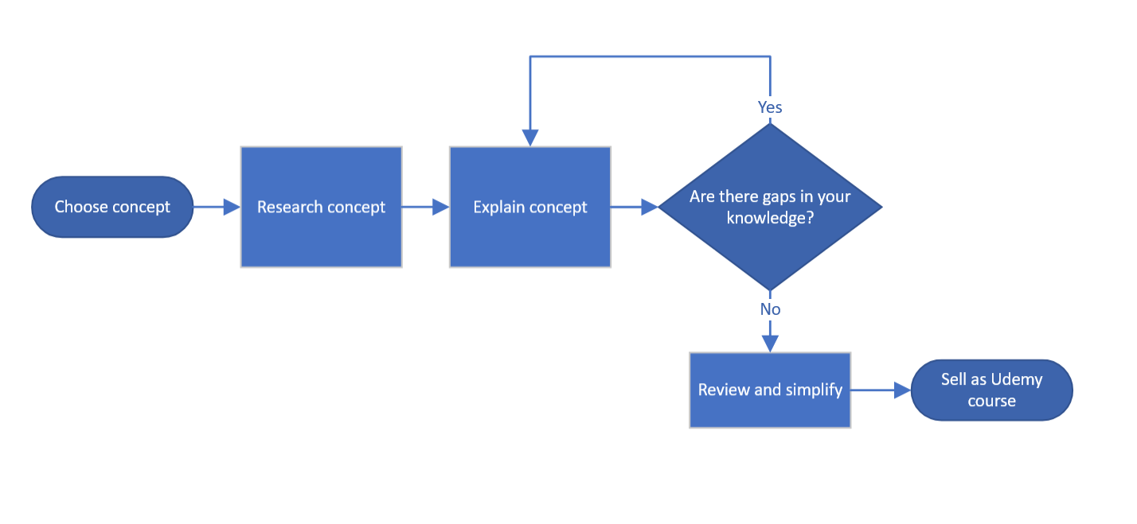

Process Mapping for learning with Feynman Technique
Good for
process mapping
REALLY good for
process mapping
Notes:
There’s no miracle people. It just happens they got interested in this thing and they learned all this stuff. There’s just people.” – Richard Feynman*
Few things have helped me to identify gaps more than having to write out a process map
Two good parts

Slide 39

Process Maps for patience and understanding
Understanding of blockers supports patience
Process maps help to communicate where blockers are most prominent
Required not just within own department but across the business
Notes:
https://www.england.nhs.uk/improvement-hub/wp-content/uploads/sites/44/2017/11/ILG-1.2-Process-Mapping-Analysis-and-Redesign.pdf

Slide 40
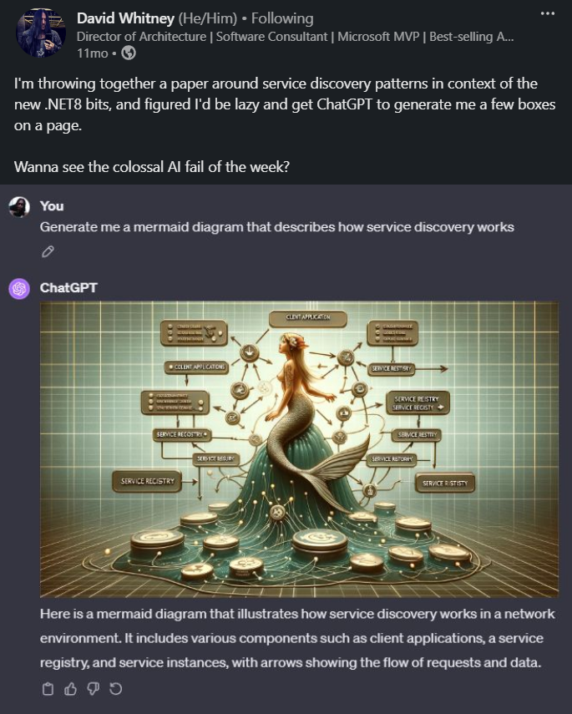

Slide 41
Tech Is Hard

Slide 42
Be excellent to each other

Slide 43
Thank you for listening!
Richard Jackson
@jacksorjacksor
Umbraco Kent Meetup | 12th November 2024

Slide 44
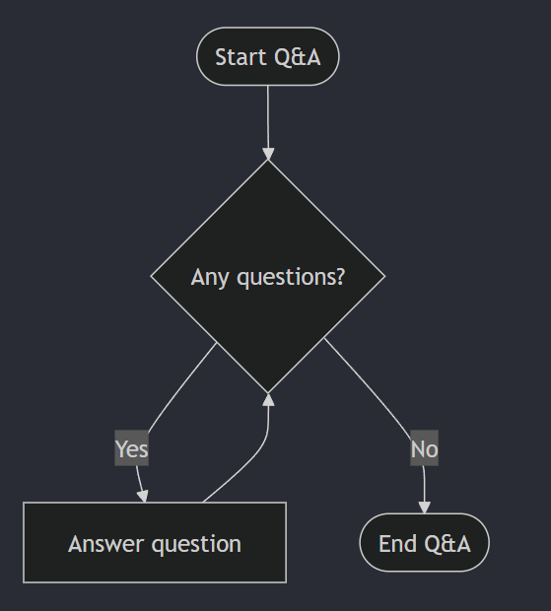
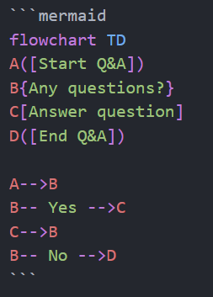
Q&A

